Slide 1

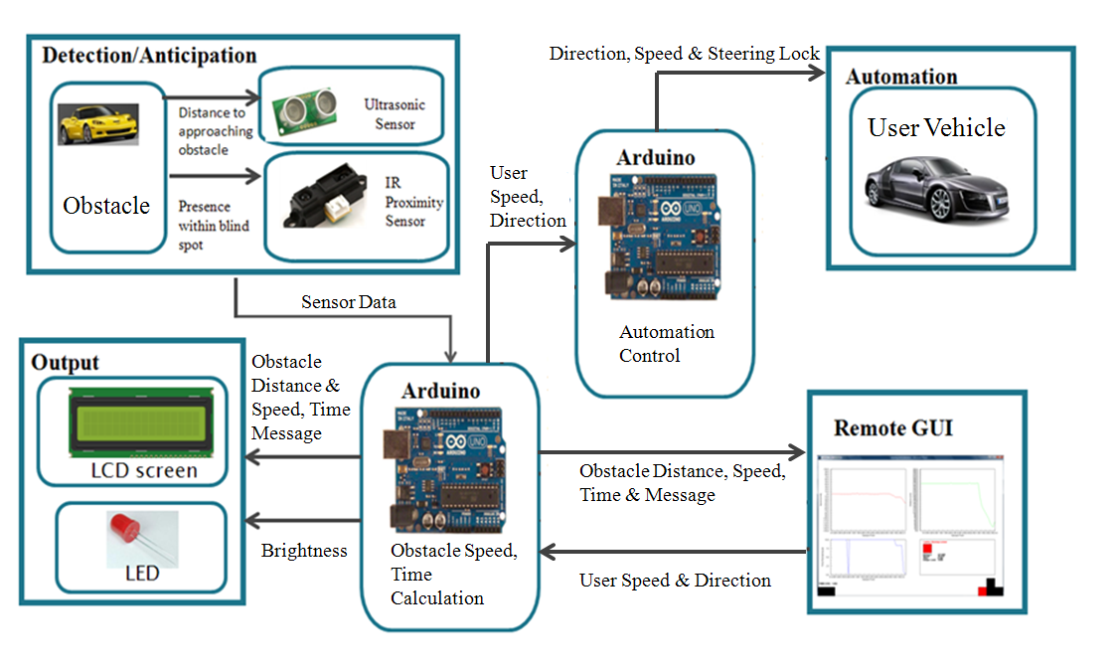
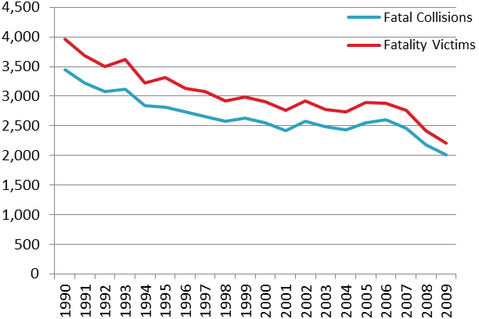
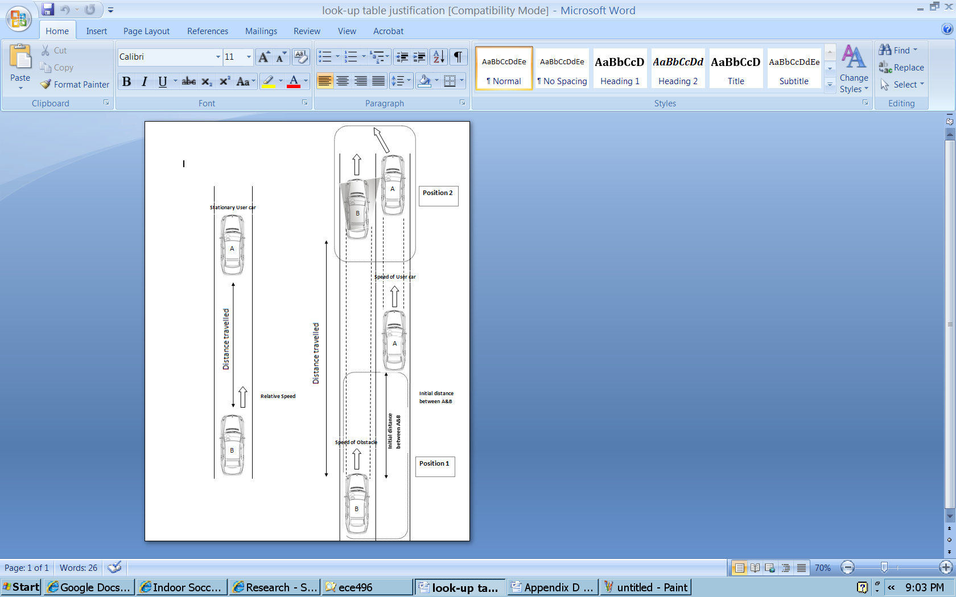
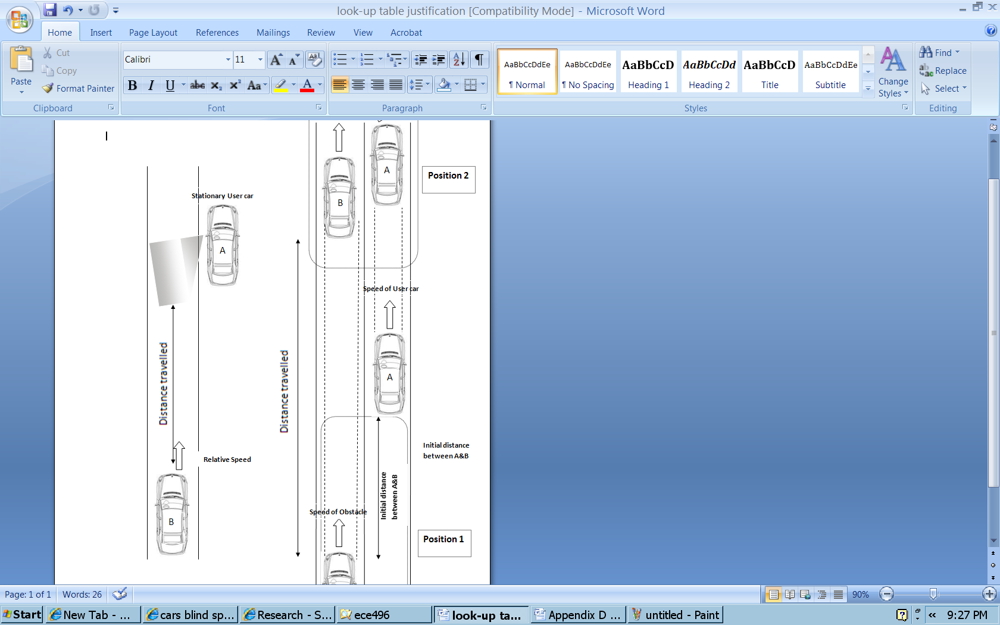
Vehicle Blind Spot Assit # 2011317
Hani Hadidi, Valikhan Kuparov, Tanzim Mokammel
Department of Electrical and Computer Engineering
University of Toronto
Motivation:
Accident during lane changes are common due to driver’s not checking their Blind Spots
Companies such as BMW, Volvo etc have implemented blind spot assist devices on their models, however, universal devices are not widely available
Accident rates are decreasing as safety technology becomes more of a concern, but there’s room for improvement
Full System Design
Results
The system was tested on 4 different subjects, which resulted in 55% efficiency in the BCI module.
Danger Levels and Output Table
Situation | Sensor Involved | Time Left [s] | Danger Level | LCD Screen Output | LED Output | Steering Locked
No Danger | Primary | t > 15 | 0 | Distance to obstacle, “No Danger” | Off | N
Obstacle Approaching | Primary | 11 < t < 15 | 1 | Distance to obstacle, relative speed, “Obstacle Approaching” | Brightness from 0% to 78%, depending on increasing distance | N
Obstacle Approaching | Primary | 6 < t < 11 | 2 |  |  | N
Obstacle Approaching | Primary | 3 < t < 6 | 3 |  |  | N
Obstacle Very Near | Primary | t < 3 | 4 | Distance to obstacle, relative speed, “Caution” | Fully On | N
Obstacle at Blind Spot | Secondary | t ≤ 0 | 5 | “Danger, Check Blind Spot” | Fully On | Y
Anticipation/Detection
Figure 5: Fatal Collisions and Fatality Victims (1990-2009)
Challenges
Acknowledgements
The team would like to thank our supervisor, Professor Bardakjian and Professor Hans Kunov for their support and feedback.
The group appreciates support by Bruno Korst and Mike Mehramiz for making the robotic arm available for use in the design lab.
Project Goal:
Assist in accident prevention through a device that will help users identify and anticipate obstacles in their vehicle’s blind spot
Provide an additional level of accident prevention through the implementation of an automated steering lock feature based on relative danger levels
Figure 3: shows signal processing, feature extraction and classification in Openvibe

